Slide 1
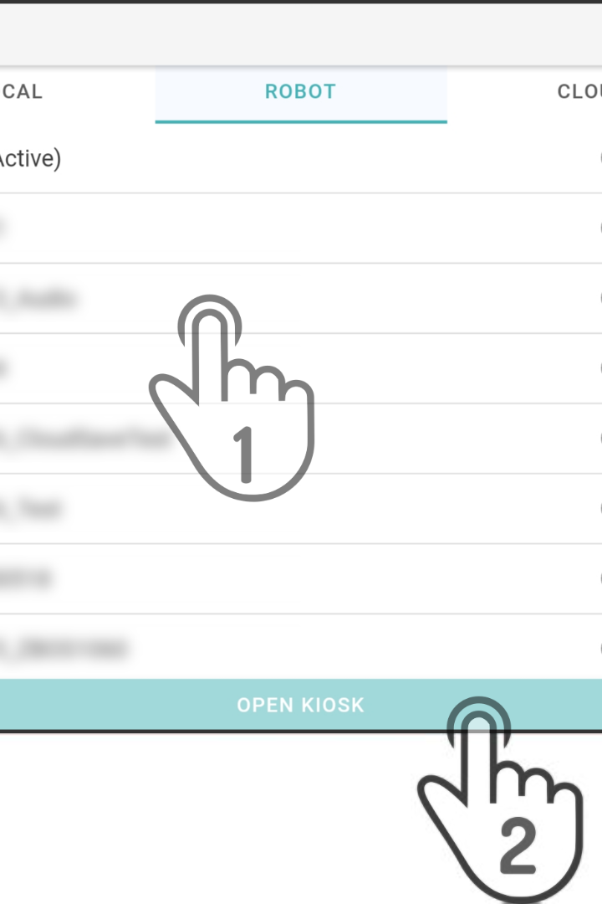

Loading and Preprocessing the Dataset
Before diving into the analysis, we need to ensure the dataset is ready for exploration. This involves loading the dataset and applying preprocessing steps such as handling missing values, data transformation, feature scaling, and more.
D
by Diviya Dharshini

Slide 2

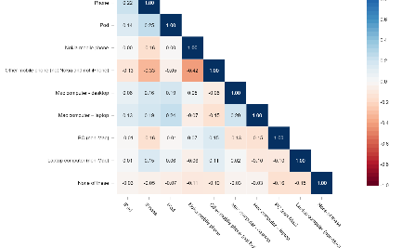
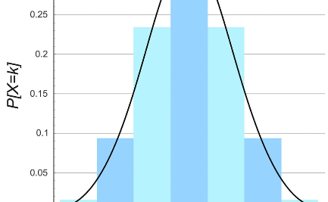
Exploratory Data Analysis
Uncover Hidden Patterns
Correlation Analysis
Data Distribution
Identify relationships between variables and discover key predictors for the target variable.
Visualize the distribution of each feature and assess its impact on the dataset.
Perform statistical analysis and visualization techniques to gain insights into the dataset.

Slide 3
Model Selection and Training
1
Algorithm Selection
Explore various algorithms and choose the most suitable one for your dataset.
Hyperparameter Tuning
2
Optimize the algorithm's performance by tuning hyperparameters using cross-validation techniques.
3
Train and Validate
Train the chosen model on the training set and validate its performance on the testing set.

Slide 4
Evaluating Model Performance
Accuracy
Precision and Recall
Measure the model's overall performance by calculating the accuracy of its predictions.
Assess the model's performance on positive and negative predictions using precision and recall metrics.
F1 Score
Confusion Matrix
Combine precision and recall into a single metric to evaluate the model's overall effectiveness.
Analyze the true positive, true negative, false positive, and false negative predictions of the model.

Slide 5

Improving Model Performance
To enhance the model's performance, consider the following strategies:
Feature Engineering: Generate new features from existing ones to capture more information.
Ensemble Methods: Combine multiple models to make more accurate predictions.
Regularization: Prevent overfitting and improve generalization using regularization techniques.
Model Stacking: Combine the predictions of multiple models to create a more robust and accurate model.

Slide 6
Interpreting the Model
Feature Importance
Partial Dependence Plot
Shapley Values
Identify the most influential features in the model's decision-making process.
Understand the contribution of each feature towards the final prediction.
Analyze the effect of individual features on the model's predictions.

Slide 7
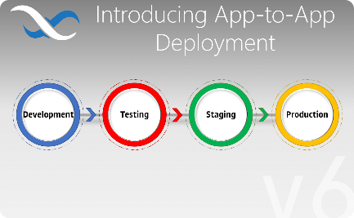
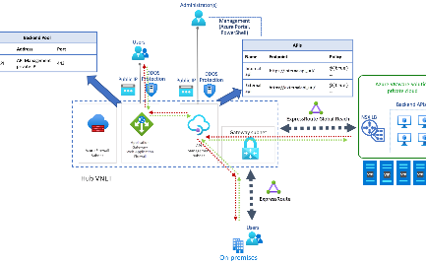
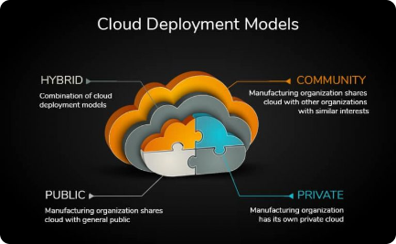
Model Deployment
Web Application
API Integration
Cloud Deployment
Build a user-friendly web interface to provide predictions to users.
Expose the model's functionality through an API to integrate with other applications.
Deploy the model in the cloud for scalability and accessibility.

Slide 8

Conclusion
By following these steps, you can efficiently load, preprocess, explore, model, evaluate, interpret, and deploy your dataset, ensuring a smooth and successful data analysis journey.

